Slide 1
Boundary conditions for Interfoam (family)
Hui Cheng
Bergen 11.01.2024

Slide 2
Questions?
How to give pressure condition in InterFoam (family) solvers?
fixedValue
prghPressure
prghTotalHydrostaticPressure
prghTotalPressure
fixedFluxPressure
zeroGradient
fixedGradient
Dirichlet
Which should be used for our simulations?
Neumann

Slide 3
References
Boundaries are usually one of the following types:
Dirichlet: fixed value
Neumann: fixed gradient
Mixed: linear combination of Dirichlet and Neumann

Slide 4
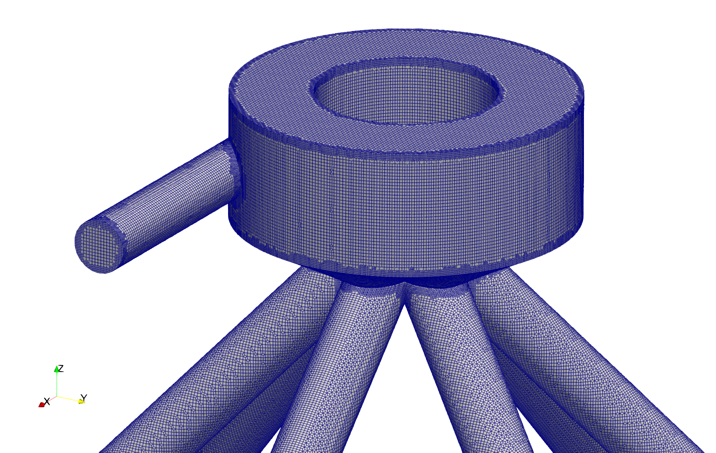
Boundary condition
Inlet conditions:
Fluid :
Velocity: 2 m/s
Pressure: zeroGradient
Kinetic energy: 0.015 m²/s²
Particles:
Injection model:
250 parcels per second
10 particles per parcel
Mass rate: 250 g per second
Inlet
Notes:
Each particle is 250/250/10= 0.1 g
fixed value

Slide 5
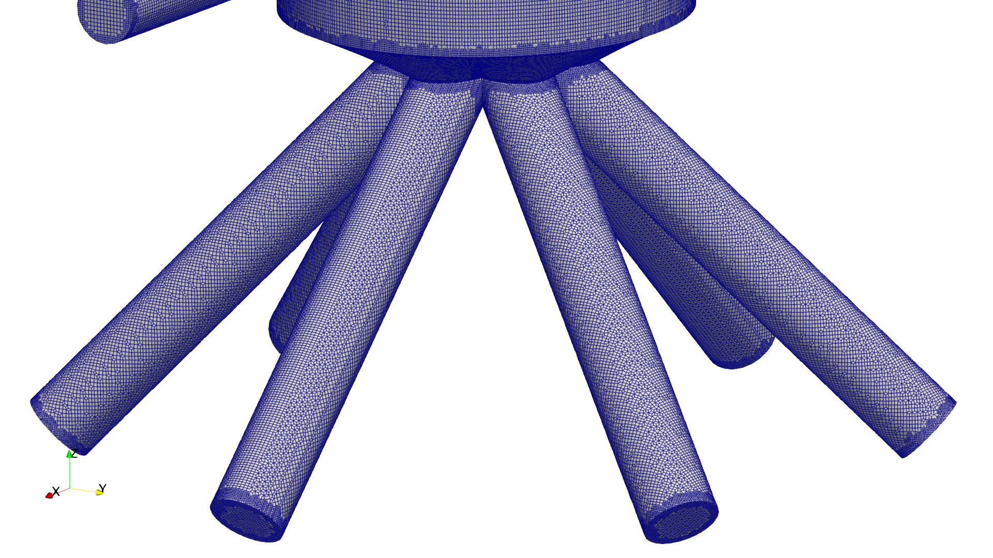
Boundary condition
Outlet conditions:
Fluid:
Velocity: zeroGradient
Pressure: 10e5
Kinetic energy: zeroGradient
Particles: escape
Outle3
Outle4
Outle5
Outle2
Outlet1
Outle6

Slide 6
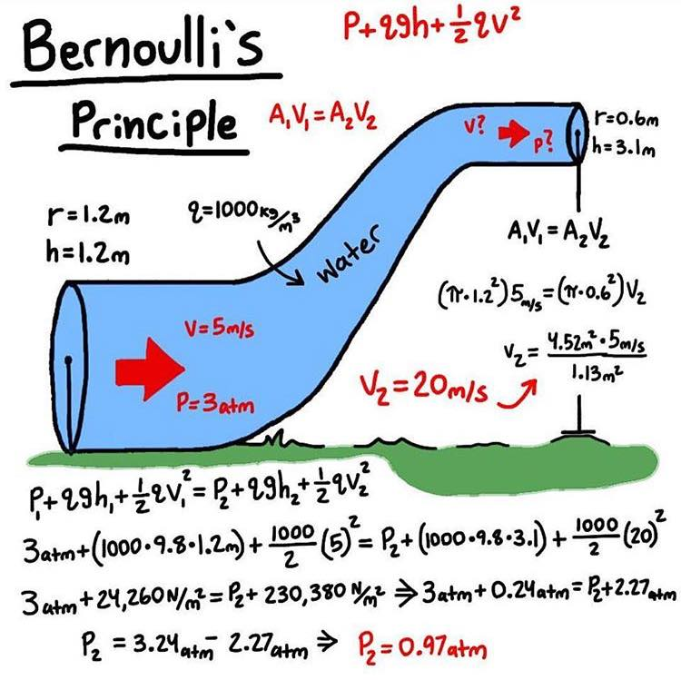
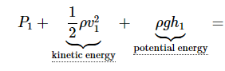
Investigation
Benchmark test is based on bernoulli’s principle
The setup is same with right figure, except that the inlet velocity is changed from 5 m/s to 1 m/s, in order to reduce the Re number and simulation time.
constant
Ideal solutions:
Velocity of the outlet should be 4 [m/s]
Pressure difference should be
Δp = p1-p2
=1000/2*(4*4-1*1)+1000*9.81*(3.1-1.2)
=7 500 +18 639
=26139 [Pa]

Slide 7
Investigation
OpenFoam v2306
Solver: MPPICInterFoam
Description
Solver for two incompressible, isothermal immiscible fluids using a VOF
(volume of fluid) phase-fraction based interface capturing approach.
The momentum and other fluid properties are of the "mixture" and a single
momentum equation is solved.
It includes MRF and an MPPIC cloud.
Turbulence modelling is generic, i.e. laminar, RAS or LES may be selected.
In the present investigate the MPPIC cloud is turn off by setting parcelsPerSecond is 0 in injectionModels.

Slide 8
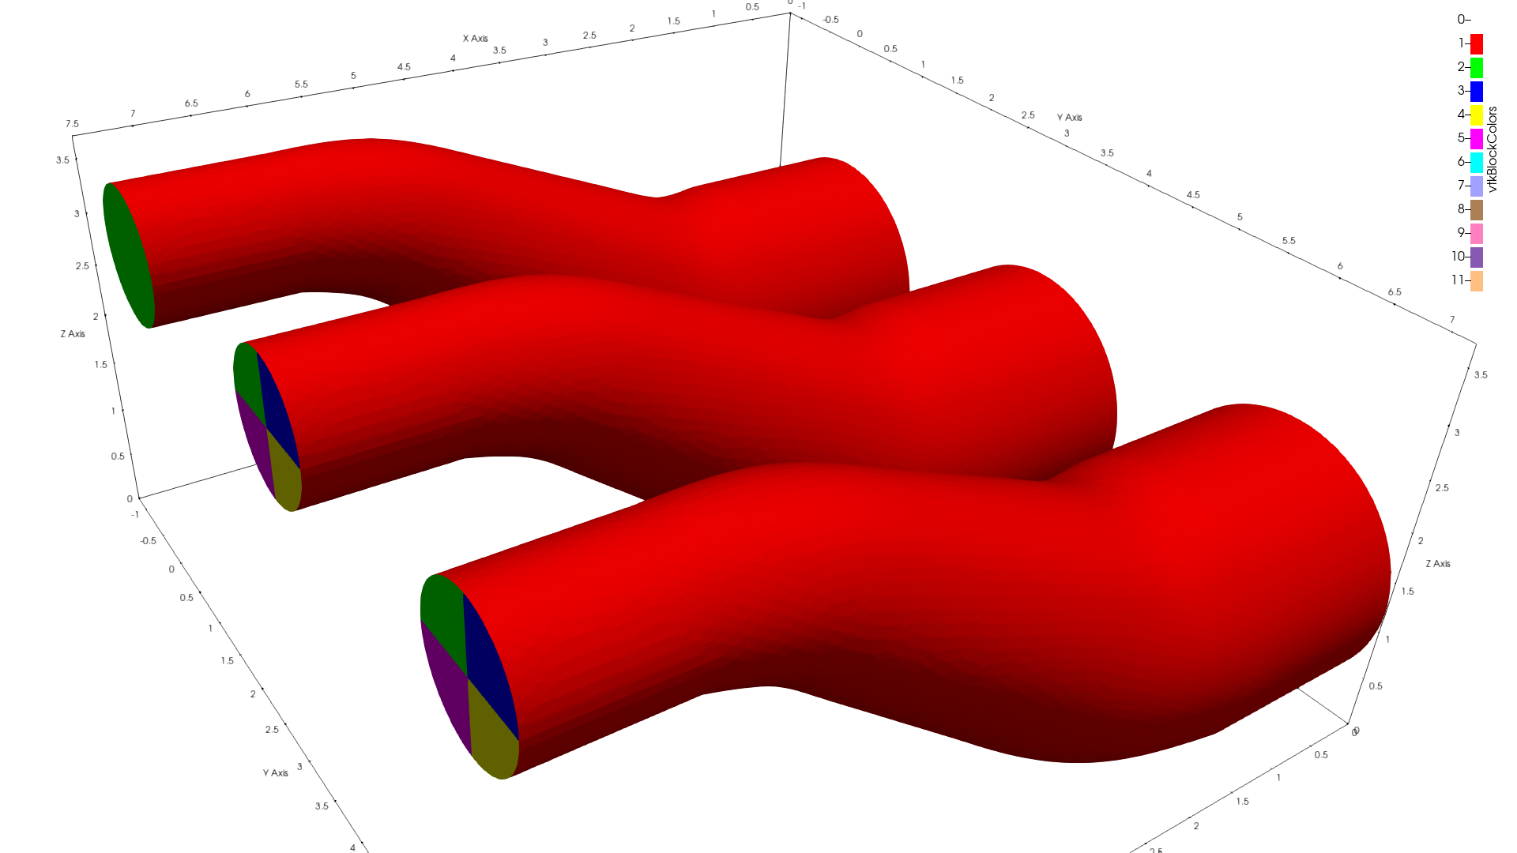
Investigation
Case1
Inlet
Wall
Outlet1
Outlet2
Outlet3
Outlet4
Case2
Case3

Slide 9
Investigation
Case1
Input values for 0/p_rgh
Case2
 | Case1 | Case2 | Case3 | Case4 | Case5
inlet | fixedFluxPressure | fixedFluxPressure | fixedFluxPressure | fixedFluxPressure | fixedFluxPressure
wall | fixedFluxPressure | fixedFluxPressure | fixedFluxPressure | fixedFluxPressure | fixedFluxPressure
Outlet1 | type prghTotalPressure, p0 uniform 0 | type prghTotalPressure, p0 uniform 0 | fixedFluxPressure | type fixedValue; value uniform 0; | type fixedValue; value uniform 0;
Outlet2 | -- | type prghTotalPressure, p0 uniform 0 | zeroGradient | -- | type fixedValue; value uniform 0;
Outlet3 | -- | type prghTotalPressure, p0 uniform 0 | type prghTotalPressure, p0 uniform 0 | -- | type fixedValue; value uniform 0;
Outlet4 | -- | type prghTotalPressure, p0 uniform 0 | type fixedGradient Gradient uniform 0; | -- | type fixedValue; value uniform 0;
Case3

Slide 10
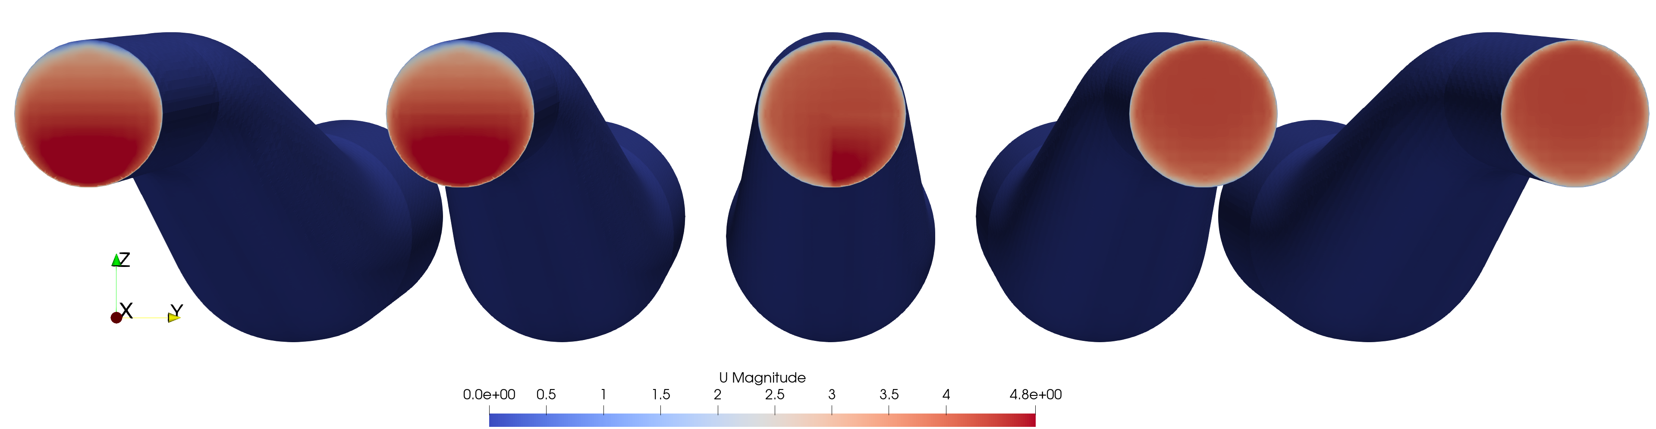
Results and conclusions
Case1&2 have the same results of u.
Case4&5 have the same results of u, and the U is more uniform in the outlet(s) than Case 1&2.
Case3 is one very different than the others.
Case1
Case2
Case3
Case4
Case5
U: point data

Slide 11
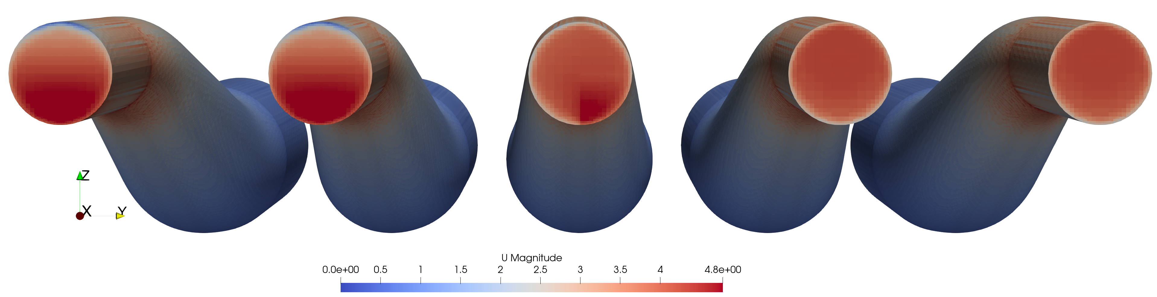
Results and conclusions
Case1&2 have the same results of u.
Case4&5 have the same results of u, and the U is more uniform in the outlet(s) than Case 1&2.
Case3 is one very different than the others.
Case1
Case2
Case3
Case4
Case5
U: cell data

Slide 12
Results and conclusions
Case4&5 have better agreements with the ideal solution, which is 4 m/s.
Fixed value condition have better results regarding the mass conservation.
 | case1 |  |  | case2 |  |  | case3 |  |  | case4 |  |  | case5
 | ux | uy | uz | ux | uy | uz | ux | uy | uz | ux | uy | uz | ux | uy | uz
inlet | 1 | 0 | 0 | 1 | 0 | 0 | 1 | 0 | 0 | 1 | 0 | 0 | 1 0 0
outlet1 | 4.01219 | -0.00023 | -0.68492 | 3.4153 | -0.12346 | -0.74139 | 3.79904 | 0.08728 | -0.17712 | 4.01291 | -0.00026 | 0.014084 | 4.10836 | -0.01246 | 0.006702
outlet2 |  |  |  | 3.41555 | 0.122034 | -0.74141 | 3.93003 | 0.068037 | -0.20138 |  |  |  | 4.10921 | 0.011702 | 0.007389
outlet3 |  |  |  | 4.6109 | -0.09582 | -0.62793 | 4.385 | 0.045245 | -0.36567 |  |  |  | 3.91772 | -0.02373 | 0.021575
outlet4 |  |  |  | 4.60811 | 0.09649 | -0.62884 | 3.93488 | 0.287125 | -0.20074 |  |  |  | 3.91641 | 0.023424 | 0.020528
outlets | 4.01219 | -0.00023 | -0.68492 | 4.012244 | -0.00025 | -0.68492 | 4.012795 | 0.121612 | -0.23641 | 4.01291 | -0.00026 | 0.014084 | 4.012975 | -0.00031 | 0.014047
Umag | 4.070232 |  |  | 4.070284 |  |  | 4.021593 |  |  | 4.012935 |  |  | 4.013
Deff % | 1.76% |  |  | 1.76% |  |  | 0.54% |  |  | 0.32% |  |  | 0.33%
Ideal solutions: Velocity of the outlet should be 4 [m/s]
Notes:
Averaged is area-weighted

Slide 13
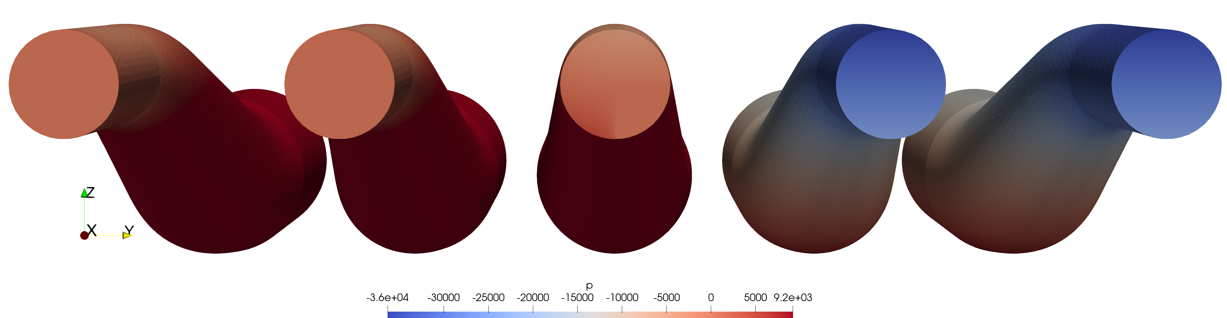
Results and conclusions
Case1&2 have the same results of p and p_rgh, case 2 have no p gradient in vertical direction.
Case4&5 have the same results of p and p_rgh, case 5 have no p_rgh gradient in vertical direction.
Case3 is the one very different than others.
Case1
Case2
Case3
Case4
Case5

Slide 14
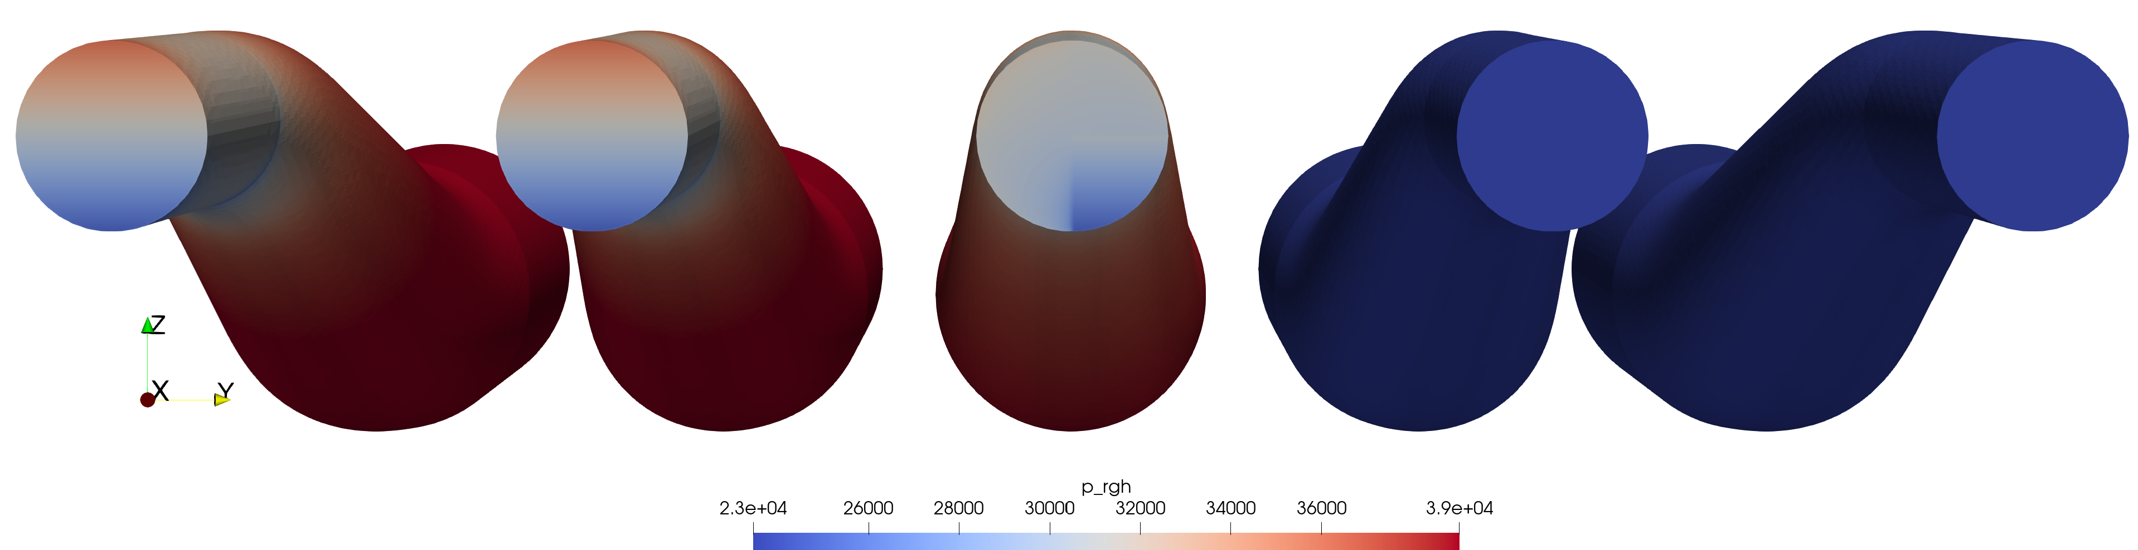
Results and conclusions
Case1&2 have the same results of p and p_rgh, case 2 have no p gradient in vertical direction.
Case4&5 have the same results of p and p_rgh, case 5 have no p_rgh gradient in vertical direction.
Case3 is the one very different than others.
Case1
Case2
Case3
Case4
Case5

Slide 15
Results and conclusions
p_rgh | case1 | case2 | case3 | case4 | case5
inlet | 39932.1 | 39937.2 | 38797.3 | 8996.05 | 8997.15
outlet1 | 30411 | 32903.4 | 30882.5 | 0 | 0
outlet2 |  | 32901.1 | 30463.2 |  | 0
outlet3 |  | 27915.9 | 27915.9 |  | 0
outlet4 |  | 27919.6 | 29670.4 |  | 0
outlets | 30411 | 30411.06 | 29731.15 | 0 | 0
Δp | 9521.1 | 9526.144 | 9066.151 | 8996.05 | 8997.15
Deff% | 26.95% | 27.02% | 20.88% | 19.95% | 19.96%
Compare with ideal solutions:
Pressure difference should be
Δp = p1-p2
=1000/2*(4*4-1*1)+1000*9.81*(3.1-1.2)
=7 500 +18 639
=26139 [Pa]
Where the dynamic pressure should be: 7 500 [Pa]
p | case1 | case2 | case3 | case4 | case5
inlet | 28160.1 | 28165.2 | 27025.3 | -2775.95 | -2774.85
outlet1 | 0 | 0 | -2020.9 | -30411 | -32903.4
outlet2 |  | 0 | -2437.94 |  | -32901.1
outlet3 |  | 0 | 0 |  | -27915.9
outlet4 |  | 0 | 1750.86 |  | -27919.6
outlets | 0 | 0 | -679.902 | -30411 | -30411.1
Δp | 28160.1 | 28165.2 | 27705.2 | 27635.05 | 27636.21
Deff% | 7.73% | 7.75% | 5.99% | 5.72% | 5.73%
Notes:
Averaged is area-weighted

Slide 16
Results and conclusions
The dynamic pressure have a difference of 20-30%, compared to the ideal solution. This does not mean the numerical results are wrong, but because the viscosity effect bring some pressure drops. This viscosity effect is not included in the ideal solution.
The total pressure drop have a difference of 5-10%, compared to the ideal solution.
The fixed value boundary condition have a smaller difference compared to the ideal solution, but not meaning a better results.
Nevertheless, fixed value boundary condition have better results regarding the mass conservation.
p_rgh is the dynamic pressure and can be set 0, independent of the boundary’s vertical locations.

Slide 17
References
pEqn.H
creatFields.H
// Update the pressure BCs to ensure flux consistency
constrainPressure(p_rgh, U, phiHbyA, rAUcf, MRF);
while (pimple.correctNonOrthogonal())
{
surfaceScalarField Dp("Dp", alphacf*rAUcf);
fvScalarMatrix p_rghEqn
(
fvm::laplacian(Dp, p_rgh)
==
fvc::ddt(alphac) + fvc::div(alphacf*phiHbyA)
);
p_rghEqn.setReference(pRefCell, getRefCellValue(p_rgh, pRefCell));
p_rghEqn.solve(mesh.solver(p_rgh.select(pimple.finalInnerIter())));
if (pimple.finalNonOrthogonalIter())
{
phi = phiHbyA - p_rghEqn.flux()/alphacf;
p_rgh.relax();
U =
HbyA
+ rAUc*fvc::reconstruct((phig - p_rghEqn.flux()/alphacf)/rAUcf);
U.correctBoundaryConditions();
fvOptions.correct(U);
}
}
#include "continuityErrs.H"
p == p_rgh + rho*gh;
#include "createRDeltaT.H"
Info<< "Reading field p_rgh\n" << endl;
volScalarField p_rgh
(
IOobject
(
"p_rgh",
runTime.timeName(),
mesh,
IOobject::MUST_READ,
IOobject::AUTO_WRITE
),
mesh
);
Source code:
In solver, only p_rgh is the one to be solved.
P is derived value.
Why? --next page
#include "readGravitationalAcceleration.H"
#include "readhRef.H"
#include "gh.H"
volScalarField p
(
IOobject
(
"p",
runTime.timeName(),
mesh,
IOobject::NO_READ,
IOobject::AUTO_WRITE
),
p_rgh + rho*gh
);

Slide 18
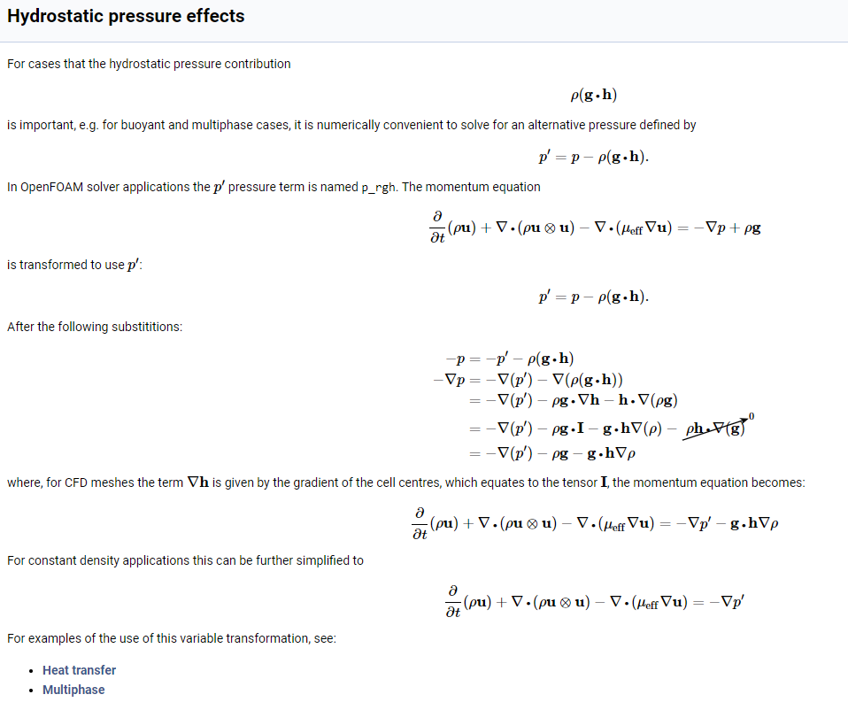
References
p or p_rgh is not the drive force to the fluid dynamic, but the gradient of the pressure is.
Link: OpenFOAM: User Guide: Hydrostatic pressure effects

Slide 19
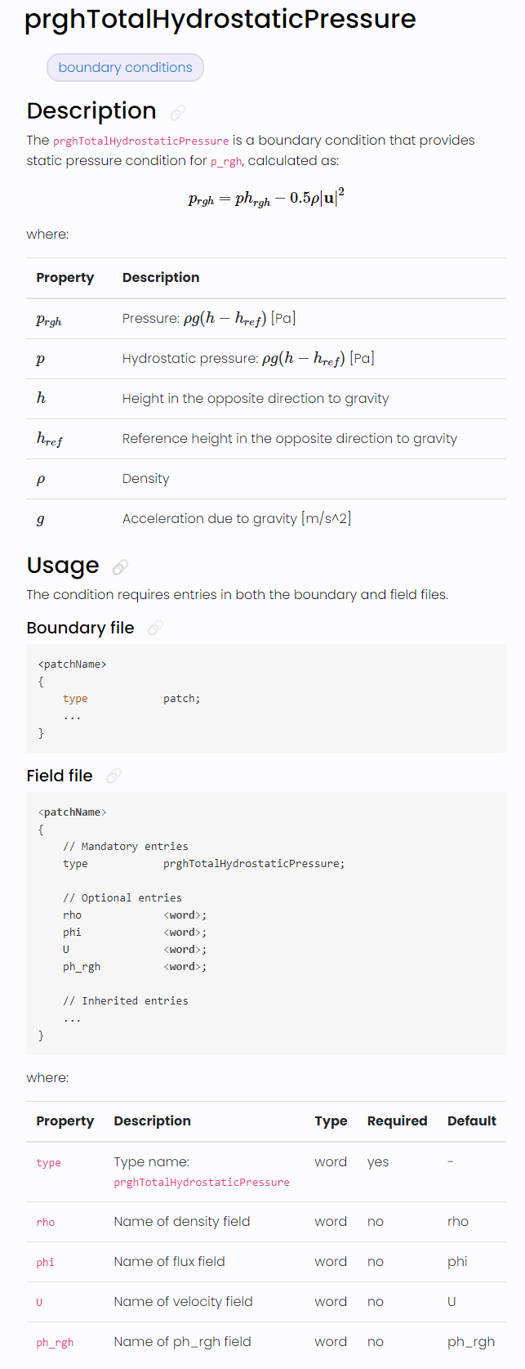
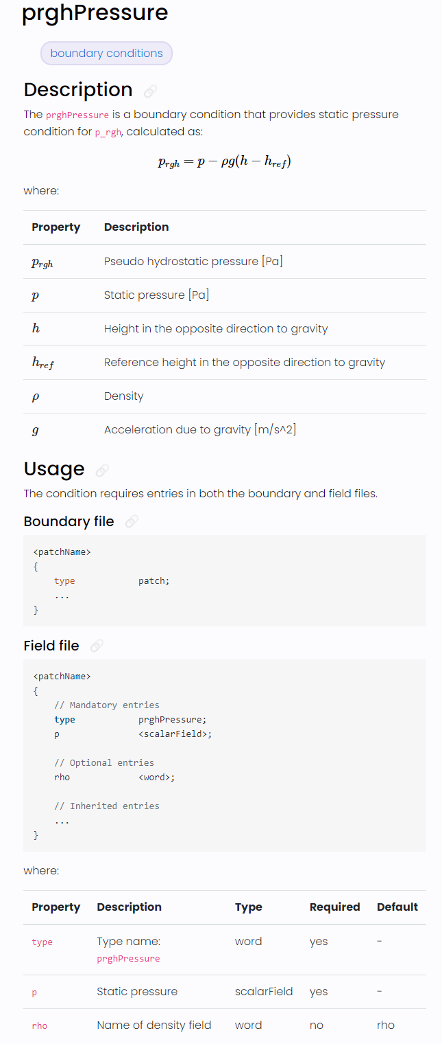
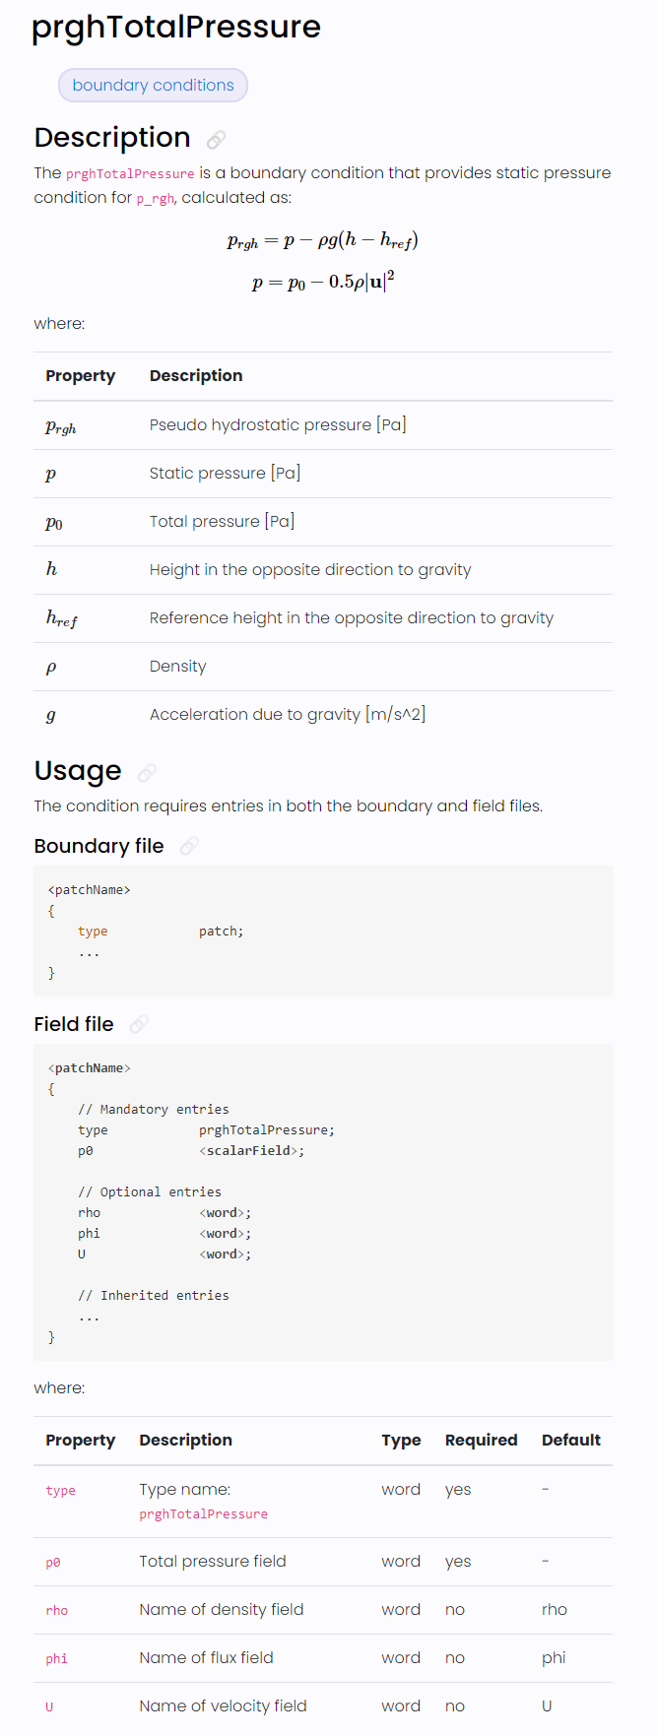
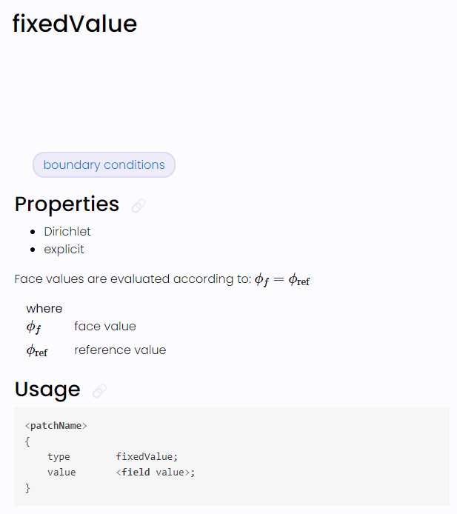
References
The inherited entries are elaborated in
Foam::fixedValueFvPatchField

